Slide 1
Outdoor learning inspired by - Birds
with
Anna Gordon
(Community Engagement and Education Advisor)

Slide 2
Today’s session:
How birds link to the curriculum
How can we attract more birds to school grounds
Fun ideas
Identification tips
What links can we make?

Slide 3
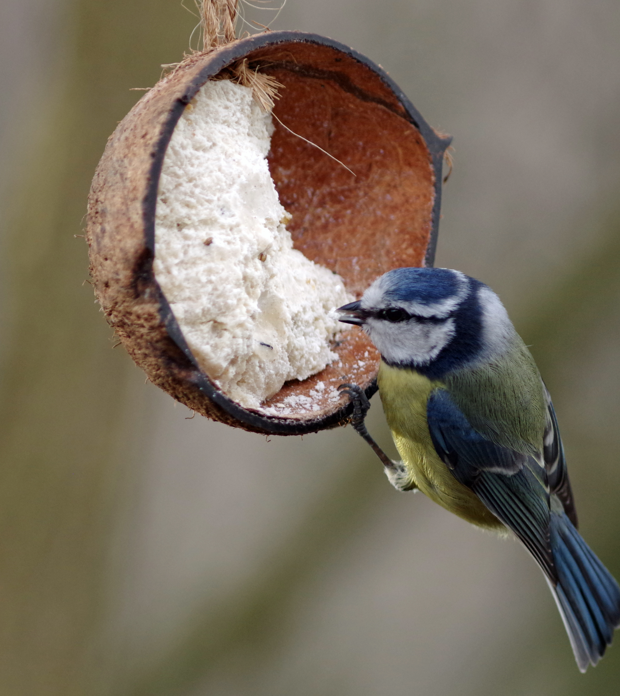
How birds link to the curriculum:
Birds Learning Objectives Document
Identify and name
Describe and compare
Habitats to which they are suited
How animals obtain their food
the basic needs of animals, including humans, for survival (water, food and air)
Notes:
Key stage 1 science of birds
Learning about birds we can cover the following objectives
KS1 scientific enquiry :
practical scientific methods, processes and skills through the teaching of the programme of study content:
asking simple questions and recognising that they can be answered in different ways
observing closely, using simple equipment
performing simple tests
identifying and classifying
using their observations and ideas to suggest answers to questions
gathering and recording data to help in answering questions.
Year 1 science :
identify and name a variety of common animals including fish, amphibians, reptiles, birds and mammals
identify and name a variety of common animals that are carnivores, herbivores and omnivores
describe and compare the structure of a variety of common animals (fish, amphibians, reptiles, birds and mammals including pets)
Year 2 science:
identify that most living things live in habitats to which they are suited and describe how different habitats provide for the basic needs of different kinds of animals and plants, and how they depend on each other
identify and name a variety of plants and animals in their habitats, including microhabitats
describe how animals obtain their food from plants and other animals, using the idea of a simple food chain, and identify and name different sources of food
notice that animals, including humans, have offspring which grow into adults
find out about and describe the basic needs of animals, including humans, for survival (water, food and air)

Slide 4
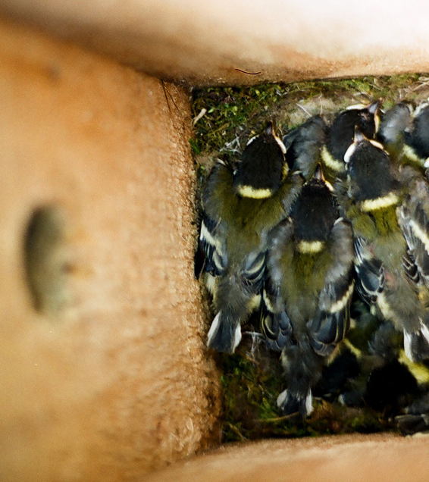
How can we attract more birds to school grounds
Greening school grounds document
Making a bird box sheet
Making bird feeders sheets
Making a bird hide sheet

Slide 5
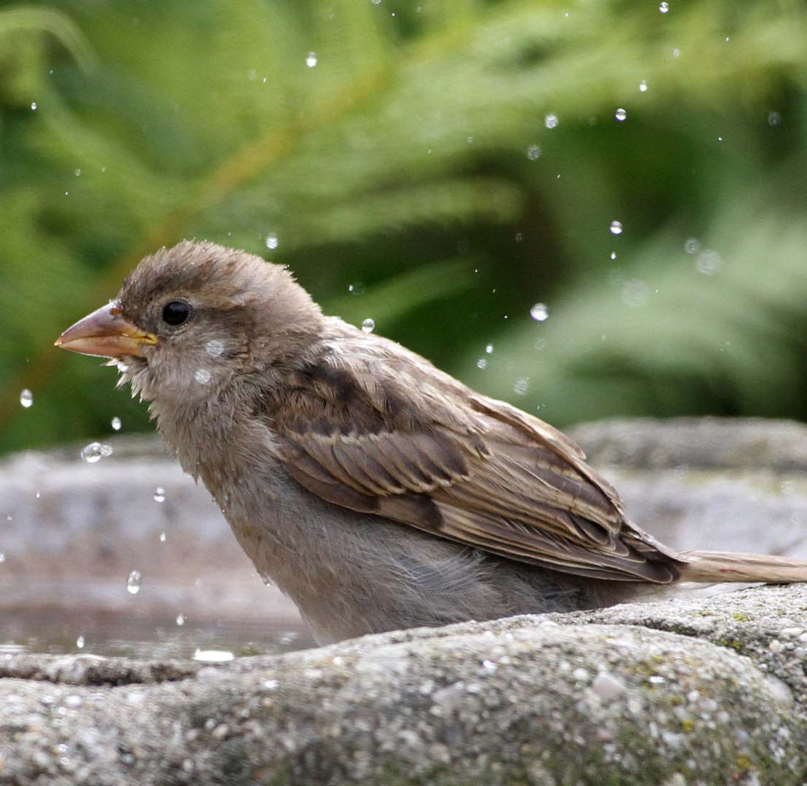
Attracting more birds in:
A feeding routine
Different types of feeding – ground based or acrobatic
Natural food sources
Look after the food chain
Remember water
Nesting

Slide 6
Fun ideas:
Science experiments
Observing and recording
Embedding in daily routine
Linking to national events eg nestbox week or big garden birdwatch

Slide 7
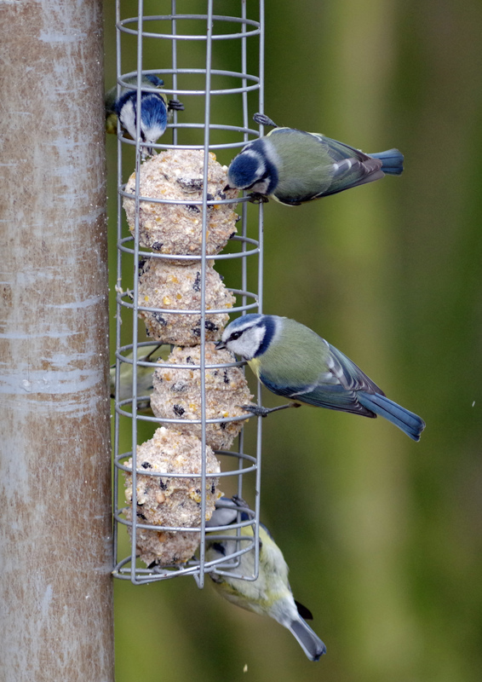
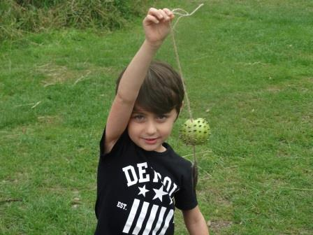
Fun to make! Design and Technology
“Fat” based designs
“Poke” designs

Slide 8
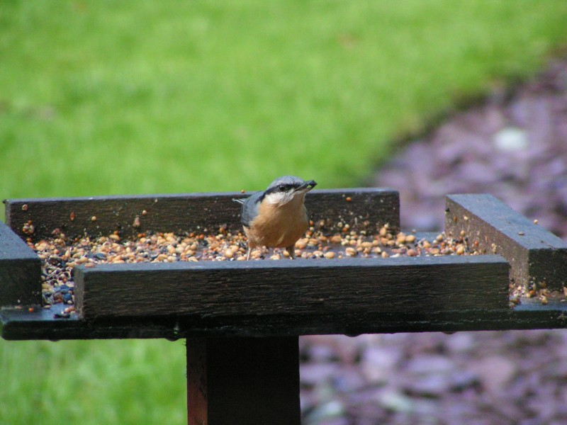
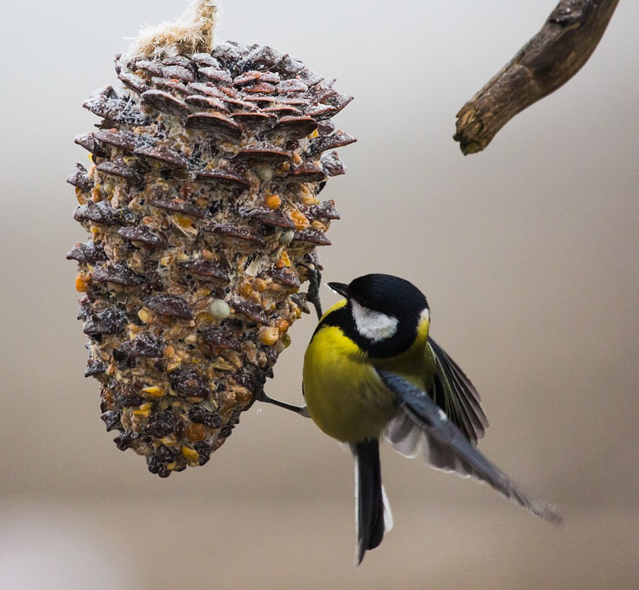
Fun to make!
Easy ways
“Fill it up” feeders

Slide 9
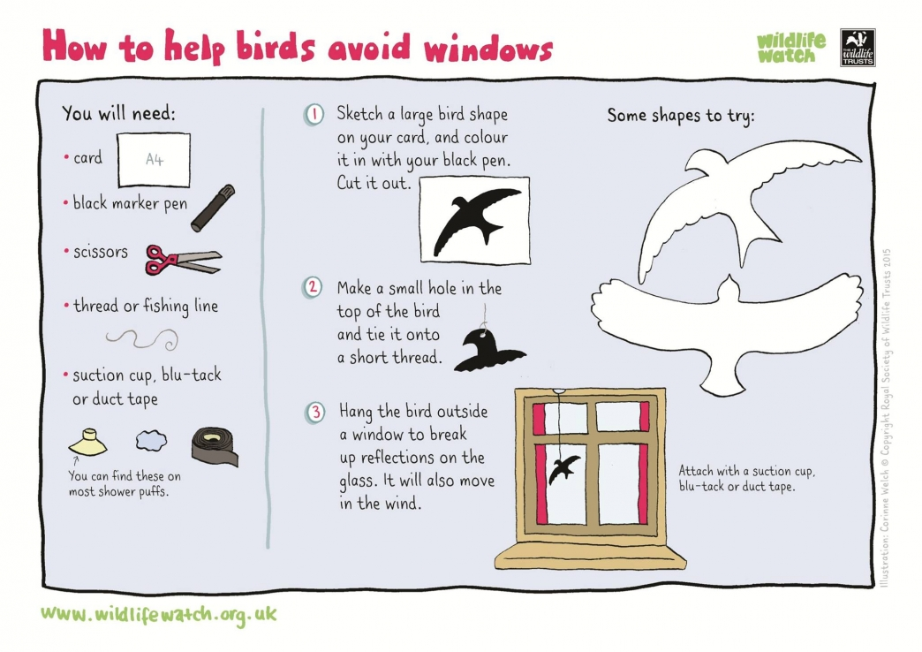
Other considerations

Slide 10
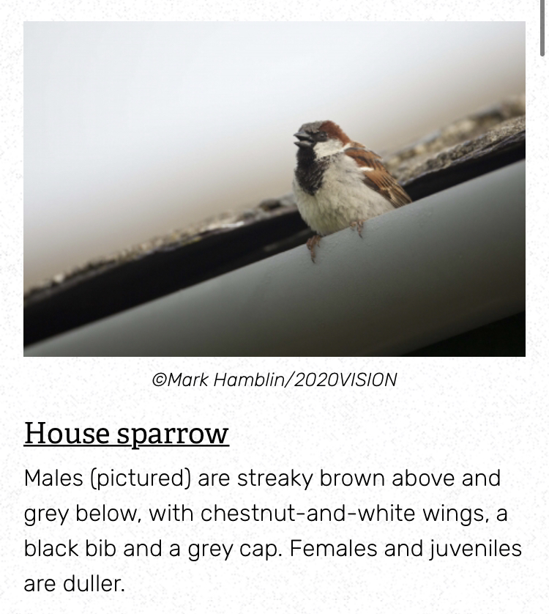
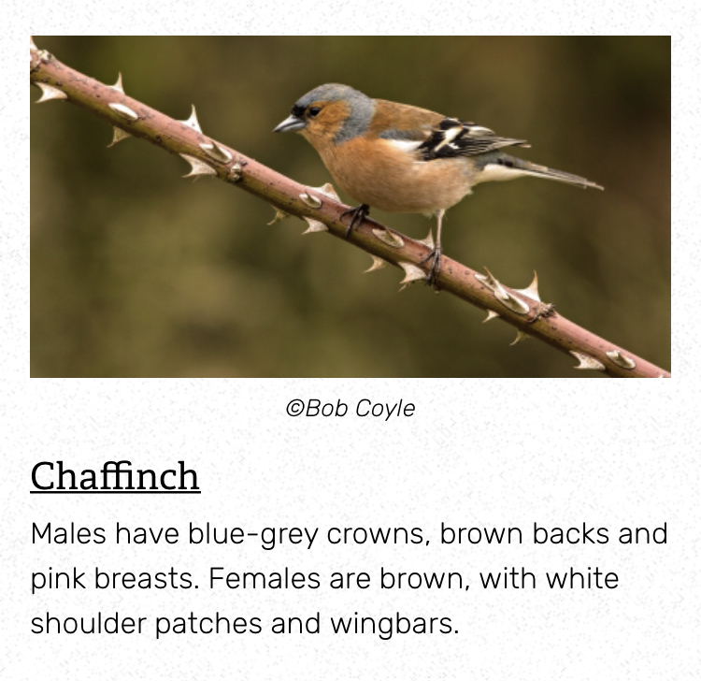
Identification tips

Slide 11
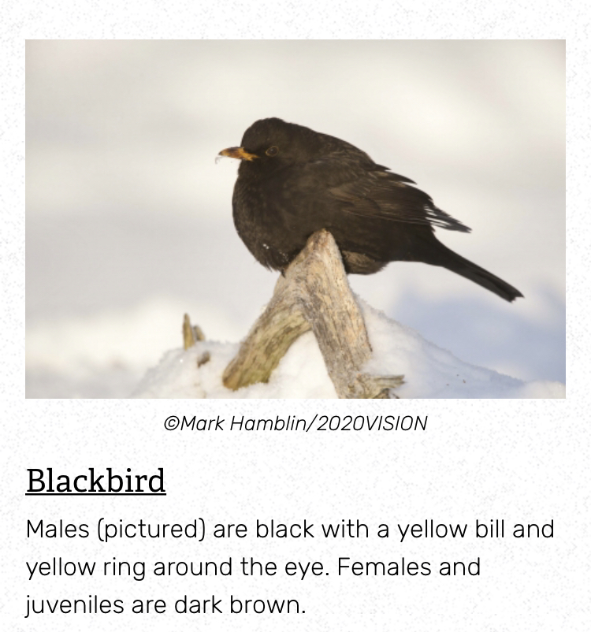
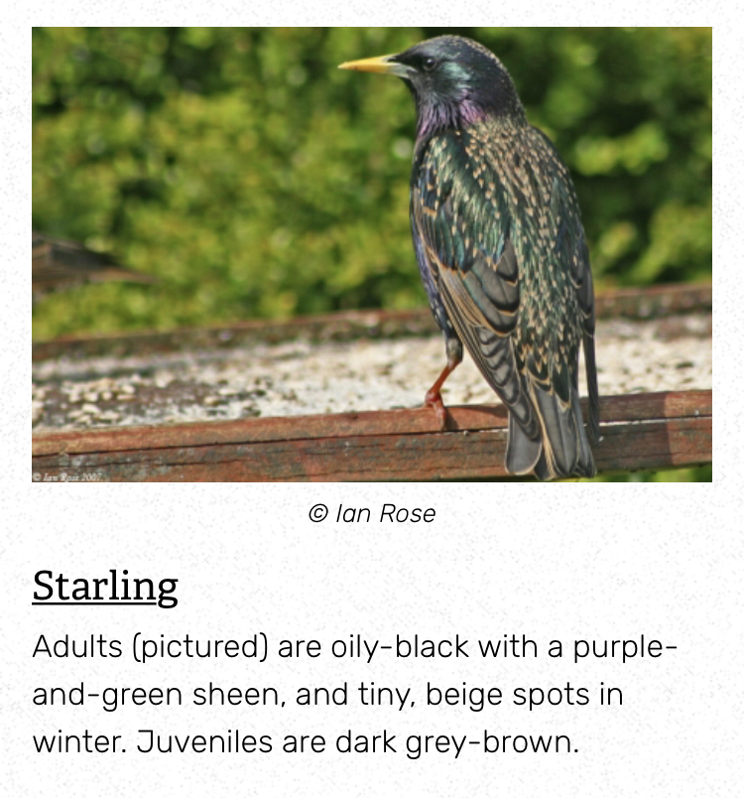
Identification tips

Slide 12
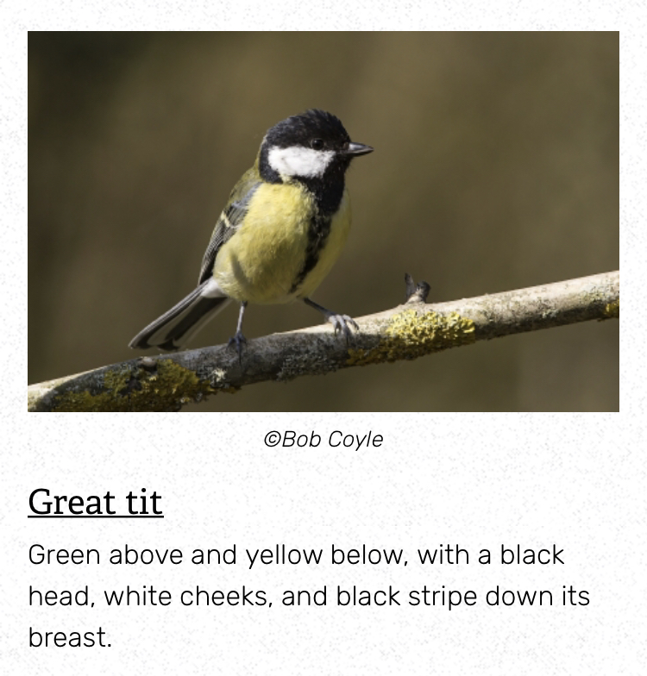
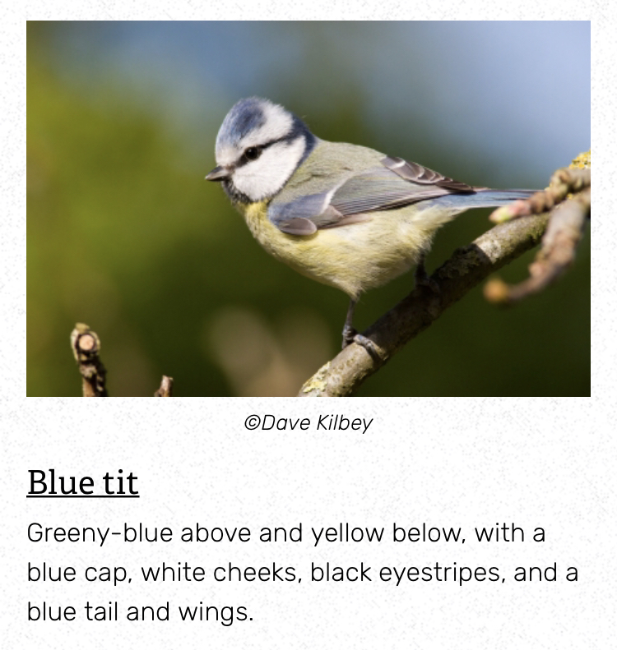
Identification tips

Slide 13
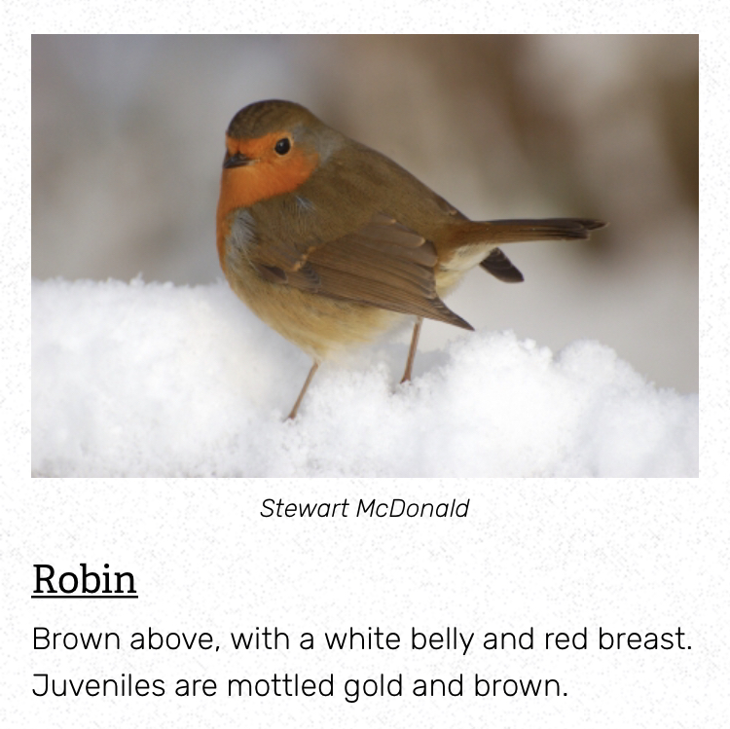
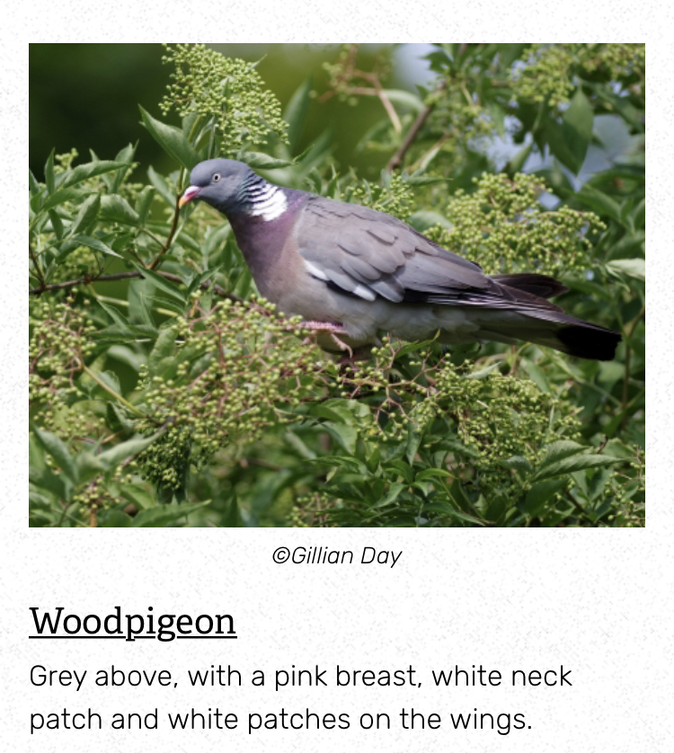
Identification tips

Slide 14
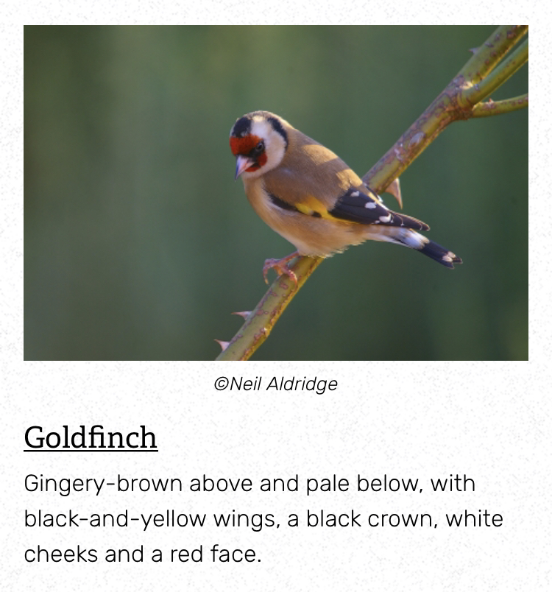
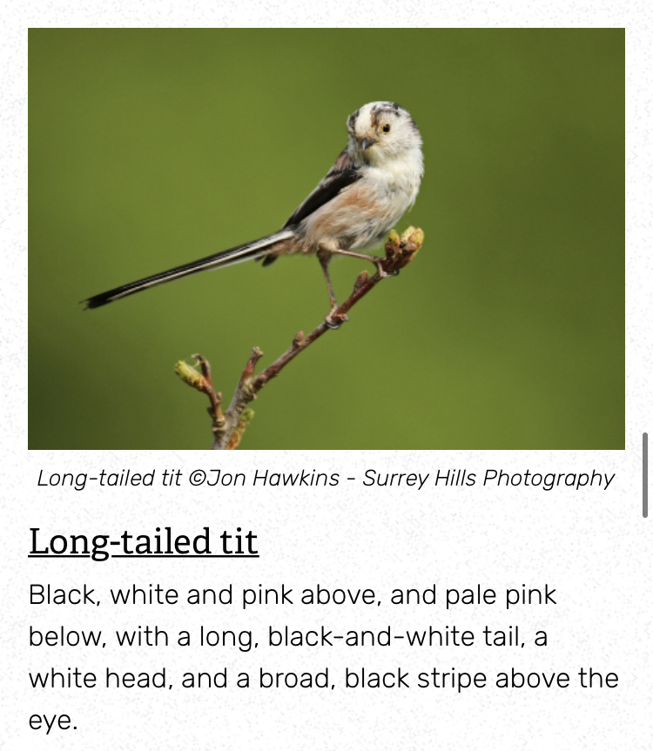
Identification tips

Slide 15
Thank you
www.wildlifetrusts.org/wildlife-explorer/birds

